Slide 1
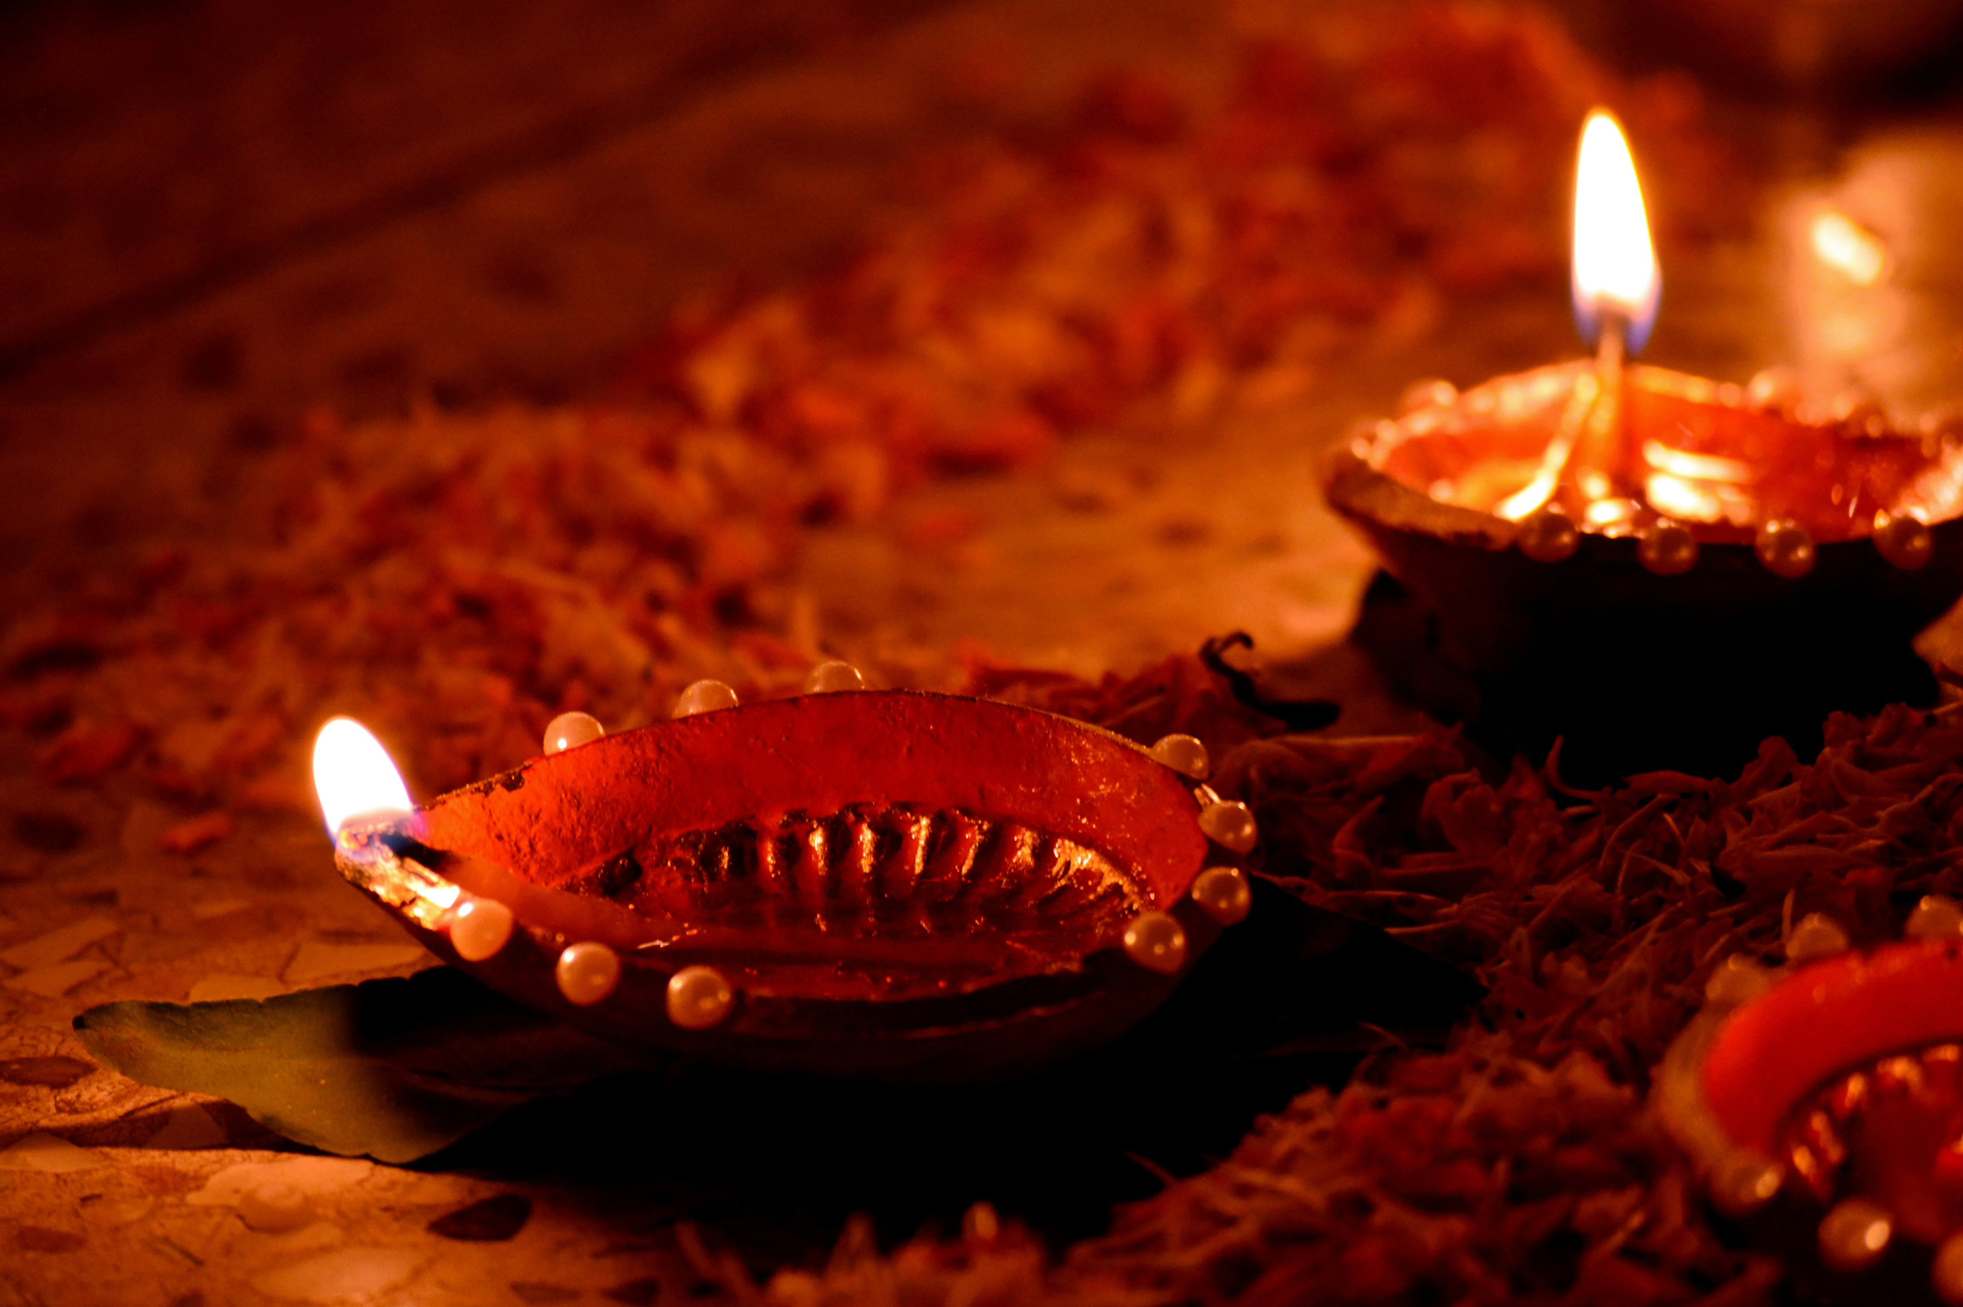
WISHING YOU A PROSPEROUS DIWALI

